Slide 1
Stanford ME469: Advection Operators… and more
Stefan P. Domino
Computational Thermal and Fluid Mechanics
Sandia National Laboratories SAND2018-4536 PE

Slide 2

Advection Operators: Outline
Classic Analysis on Advection/Diffusion/Time Scalar Transport
The Advection Operator and the Role of $\dot{m}$
Revisit the Projected Nodal Gradient
Diagonal Dominance
Upwind Methods
Linear Residual-Based Stabilization
Nonlinear Residual-Based Stabilization
Conclusions

Slide 3
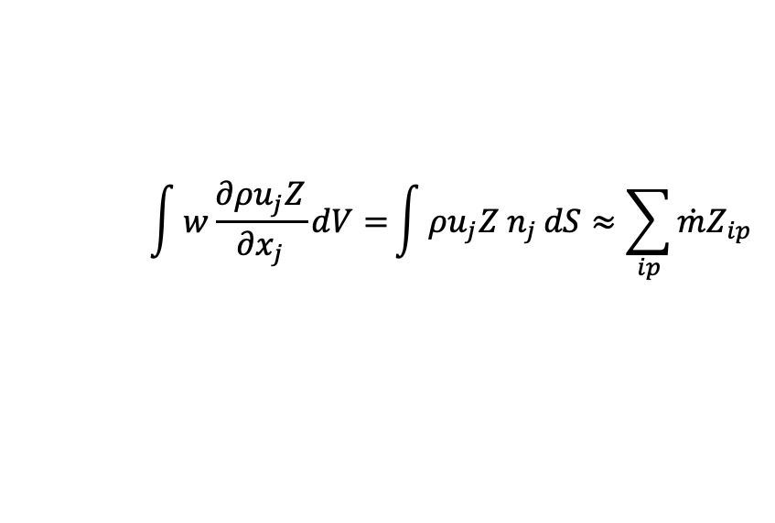
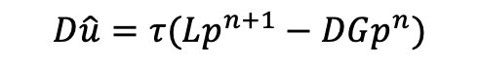
First, The Role of $\dot{m }$
For an equal-order, low-Mach approximate projection scheme, explicit pressure stabilization was added. How does this manifest itself in the advection operator?
Recall discrete continuity solve
$$\int{w\frac{∂ρu_{j}Z}{∂x_{j}}dV=}\int{ρu_{j}Z n_{j}}dS≈\sum_{ip}{\dot{m}Z_{ip}}$$
$$D\hat{u}=τ(Lp^{n+1}−DGp^{n})$$

Slide 4
First, The Role of $\dot{m }$
For an equal-order, low-Mach approximate projection scheme, explicit pressure stabilization was added. How does this manifest itself in the advection operator?
Recall discrete continuity solve
$$\int{w\frac{∂ρu_{j}Z}{∂x_{j}}dV=}\int{ρu_{j}Z n_{j}}dS≈\sum_{ip}{\dot{m}Z_{ip}}$$
$$D\hat{u}=τ(Lp^{n+1}−DGp^{n})$$
j-2
j-1
_{j-1/2}
j
_{j+1/2}
j+1
j+2

Slide 5
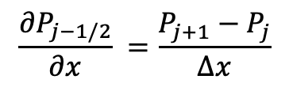
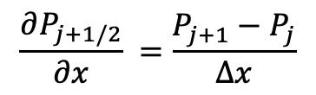
First, The Role of $\dot{m }$
For an equal-order, low-Mach approximate projection scheme, explicit pressure stabilization was added. How does this manifest itself in the advection operator?
Recall discrete continuity solve
$$\int{w\frac{∂ρu_{j}Z}{∂x_{j}}dV=}\int{ρu_{j}Z n_{j}}dS≈\sum_{ip}{\dot{m}Z_{ip}}$$
$$D\hat{u}=τ(Lp^{n+1}−DGp^{n})$$
$$\frac{∂P_{j−1/2}}{∂x} =\frac{P_{j+1}−P_{j}}{∆x}$$
$$\frac{∂P_{j+1/2}}{∂x} =\frac{P_{j+1}−P_{j}}{∆x}$$
j-2
j-1
_{j-1/2}
j
_{j+1/2}
j+1
j+2

Slide 6
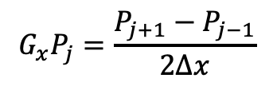
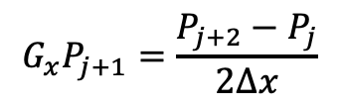
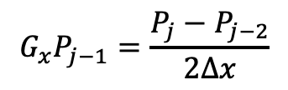
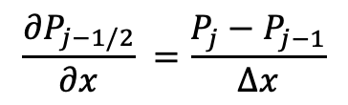
First, The Role of $\dot{m }$
For an equal-order, low-Mach approximate projection scheme, explicit pressure stabilization was added. How does this manifest itself in the advection operator?
Recall discrete continuity solve
$$\int{w\frac{∂ρu_{j}Z}{∂x_{j}}dV=}\int{ρu_{j}Z n_{j}}dS≈\sum_{ip}{\dot{m}Z_{ip}}$$
$$D\hat{u}=τ(Lp^{n+1}−DGp^{n})$$
$$\frac{∂P_{j−1/2}}{∂x} =\frac{P_{j}−P_{j−1}}{∆x}$$
$$\frac{∂P_{j+1/2}}{∂x} =\frac{P_{j+1}−P_{j}}{∆x}$$
j-2
j-1
_{j-1/2}
j
_{j+1/2}
j+1
j+2
$$G_{x}P_{j−1}=\frac{P_{j}−P_{j−2}}{2∆x}$$
$$G_{x}P_{j}=\frac{P_{j+1}−P_{j−1}}{2∆x}$$
$$G_{x}P_{j+1}=\frac{P_{j+2}−P_{j}}{2∆x}$$

Slide 7
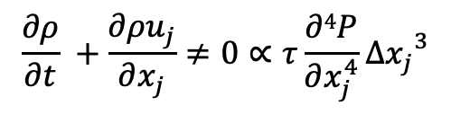
First, The Role of $\dot{m }$
For an equal-order, low-Mach approximate projection scheme, explicit pressure stabilization was added. How does this manifest itself in the advection operator?
Using the above equations, we can derive the actual continuity equation that we are solving:
Recall discrete continuity solve
$$\int{w\frac{∂ρu_{j}Z}{∂x_{j}}dV=}\int{ρu_{j}Z n_{j}}dS≈\sum_{ip}{\dot{m}Z_{ip}}$$
$$D\hat{u}=τ(Lp^{n+1}−DGp^{n})$$
$$\frac{∂P_{j−1/2}}{∂x} =\frac{P_{j}−P_{j−1}}{∆x}$$
$$\frac{∂P_{j+1/2}}{∂x} =\frac{P_{j+1}−P_{j}}{∆x}$$
j-2
j-1
_{j-1/2}
j
_{j+1/2}
j+1
j+2
$$G_{x}P_{j−1}=\frac{P_{j}−P_{j−2}}{2∆x}$$
$$G_{x}P_{j}=\frac{P_{j+1}−P_{j−1}}{2∆x}$$
$$G_{x}P_{j+1}=\frac{P_{j+2}−P_{j}}{2∆x}$$
$$\frac{∂ρ}{∂t} +\frac{∂ρu_{j}}{∂x_{j}}≠0∝τ\frac{∂4P}{∂x_{j}^{4}}{∆x_{j}}^{3}$$

Slide 8
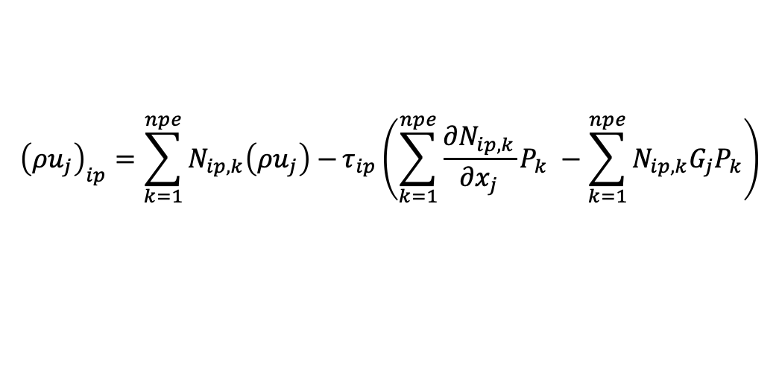
Now, the hard choice….
We have already seen that the continuity equation includes a fourth-order pressure derivative, at least when using the standard fine-scale momentum residual stabilization approach
Moreover, even order derivatives are stabilizing (suppresses growth via dissipation)
Two notions of velocity:
The nodal velocity whose divergence (in a uniform density flow) is proportional to the fourth-order pressure derivative
The integration point velocity, or convecting velocity, that includes the L-DG term
Inclusion of the pressure stabilization terms in the mass flow rate ensures that the DOF is conserved, however, in some parts of the literature, this is not clearly represented and sometimes these terms are dropped.
Inclusion of these pressure stabilization terms in momentum also provides a dissipative quality and, as such the system is not perfectly kinetic energy conserving, You et al., PoF, 2008, https://doi.org/10.1063/1.3006077
$${\left(ρu_{j}\right)}_{ip}=\sum_{k=1}^{npe}{N_{ip,k}\left(ρu_{j}\right)−}τ_{ip}\left(\sum_{k=1}^{npe}{\frac{{∂N}_{ip,k}}{∂x_{j}}P_{k}} −\sum_{k=1}^{npe}{N_{ip,k}G_{j}P_{k}}\right)$$

Slide 9
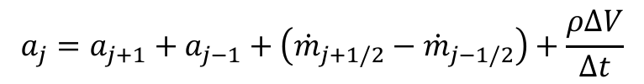
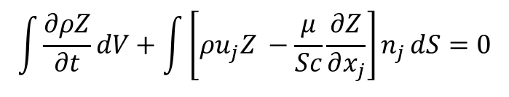
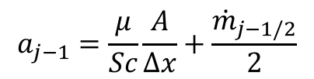
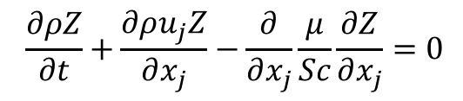
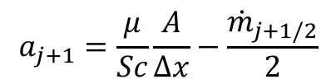
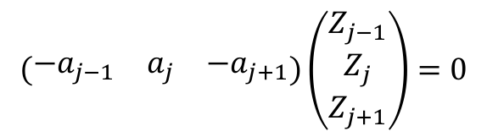
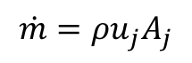
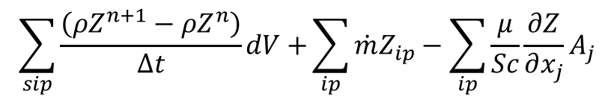
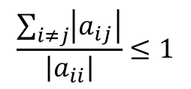
Consider a Simple Advection/Diffusion/Time Scalar Transport
$$\frac{∂ρZ}{∂t}+\frac{∂ρu_{j}Z}{∂x_{j}}−\frac{∂}{∂x_{j}}\frac{μ}{Sc}\frac{∂Z}{∂x_{j}}=0$$
PDE is given by:
Integral form:
Discrete form:
Matrix Form:
$$\int{\frac{∂ρZ}{∂t}dV+\int{\left[ρu_{j}Z −\frac{μ}{Sc}\frac{∂Z}{∂x_{j}}\right]n_{j}}dS=0}$$
$$\sum_{sip}{\frac{\left(ρZ^{n+1}−ρZ^{n}\right)}{Δt}dV+}\sum_{ip}{\dot{m}Z_{ip}−\sum_{ip}{\frac{μ}{Sc}}}\frac{∂Z}{∂x_{j}}A_{j}$$
Mass flow rate:
$$\dot{m}=ρu_{j}A_{j}$$
$$\left(\begin{matrix}−a_{j−1} & a_{j} & −a_{j+1}\end{matrix}\right)\left(\begin{matrix}Z_{j−1} \\ Z_{j} \\ Z_{j+1}\end{matrix}\right)=0$$
$$a_{j+1}=\frac{μ}{Sc}\frac{A}{Δx}−\frac{{\dot{m}}_{j+1/2}}{2}$$
$$a_{j−1}=\frac{μ}{Sc}\frac{A}{Δx}+\frac{{\dot{m}}_{j−1/2}}{2}$$
$$\frac{\sum_{i≠j}{\left|a_{ij}\right|}}{\left|a_{ii}\right|}≤1$$
$$a_{j}=a_{j+1}+a_{j−1}+\left({\dot{m}}_{j+1/2}−{\dot{m}}_{j−1/2}\right)+\frac{ρΔV}{Δt}$$
j-1
j
j+1

Slide 10
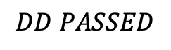
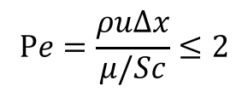
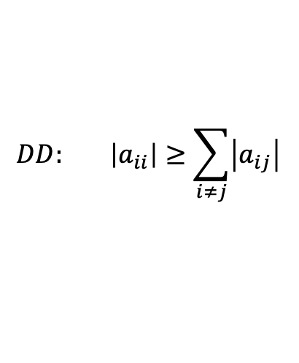
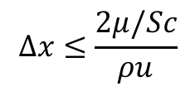
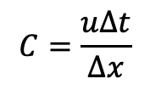
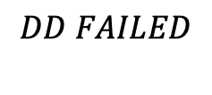
Diagonal Dominance Check
For a monotonic operator and ease of solving the linear system, , diagonal dominance is desired :
Consider u = 1 cm/s; ρ = 1.2e-3 g/cm3; μ/Sc = 1.8e-4 g/cm-s; Δx = 0.1 cm; ; Δt >> 1:
a_{j+1}=1.2e-5 a_{j-1}=2.4e-5 a_{j} = 3.6e-5
Stable and monotonic field will be realized; Re based on length scale = 0.67
Consider u = 10 cm/s; ρ = 1.2e-3 g/cm3; μ/Sc = 1.8e-4 g/cm-s; Δx = 0.1 cm; Δt >> 1:
a_{j+1}=-4.2e-5 a_{j-1}=7.8e-5 a_{j} = 3.605e-5
Unstable and lack of scalar monotonicity will be realized; Re based on length scale = 6.7
Standard preconditioner, e.g., SGS, are not expected to converge the linear system
Mesh spacing for monotonicity must be:
Cell Peclet number, Pe is a cell-Reynolds number based on local properties and mesh spacing
Consider u = 10 cm/s; ρ = 1.2e-3 g/cm3; μ/Sc = 1.8e-4 g/cm-s; Δx = 0.1 cm; Δt =?
For diagonal dominance, Δt = 0.0143 which corresponds to a Courant number of unity
$$DD: \left|a_{ii}\right|≥\sum_{i≠j}{\left|a_{ij}\right|}$$
$$DD PASSED$$
$$DD FAILED$$
$$Δx≤\frac{2μ/Sc}{ρu}$$
$$Pe=\frac{ρuΔx}{μ/Sc}≤2$$
$$C=\frac{uΔt}{Δx}$$

Slide 11
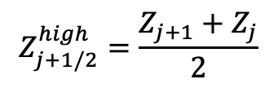
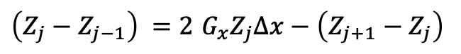
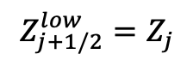
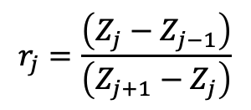
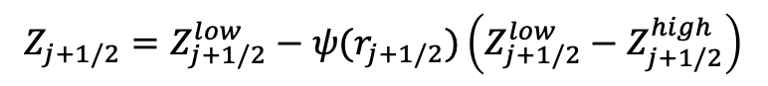
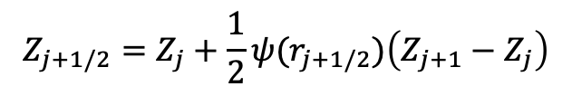
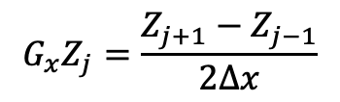
Classic Flux Limiters Van Leer, B. (1974), "Towards the ultimate conservative difference scheme II. Monotonicity and conservation combined in a second order scheme", J. Comput. Phys., 14 (4): 361–370
u_{x}
Consider our standard three-point stencil obtained by iterating edge 1 and 2
In the above stencil, we are stressing that when iterating edge 2, we do not have information easily obtain for edge 1 (shown above as a dotted line); (speaking from an unstructured perspective)
j-1
Z_{j-1/2}
j
Z_{j+1/2}
j+1
Edge 1
Edge 2
Let:
$$Z_{j+1/2}=Z_{j+1/2}^{low}−ψ(r_{j+1/2})\left(Z_{j+1/2}^{low}−Z_{j+1/2}^{high}\right)$$
$$Z_{j+1/2}^{low}=Z_{j}$$
$$Z_{j+1/2}^{high}=\frac{Z_{j+1}+Z_{j}}{2}$$
$$Z_{j+1/2}=Z_{j}+\frac{1}{2}ψ(r_{j+1/2})\left(Z_{j+1}−Z_{j}\right)$$
if
and
, then
$$r_{j}=\frac{\left(Z_{j}−Z_{j−1}\right)}{\left(Z_{j+1}−Z_{j}\right)}$$
Defining:
(with extrapolation)
$\left(Z_{j}−Z_{j−1}\right) =2$ $G_{x}Z_{j}∆x−\left(Z_{j+1}−Z_{j}\right)$
Recall:
$$G_{x}Z_{j}=\frac{Z_{j+1}−Z_{j−1}}{2∆x}$$

Slide 12
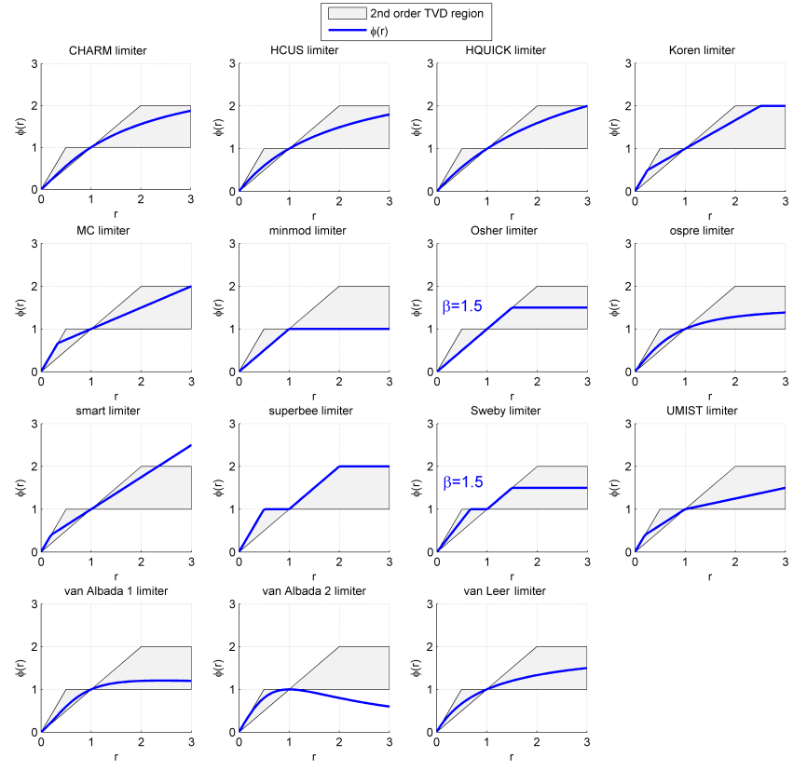
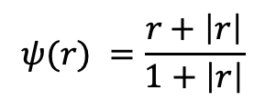
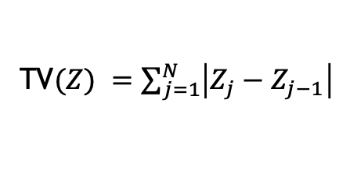
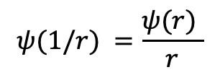
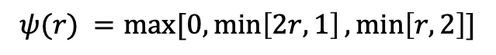
Flux Limiter Definition
Sweby (1984) defined set of permissible limiter regions for the desired second-order accurate methods: A sampling of the Sweby Diagram
For a monotonically increasing function, TV(Z) = |Z₁ −Z_{N} |. Note that if Z₁ and Z_{N} are taken constant, then, as long as the function remains monotonic the total variation is constant
However, if TV(Z) increases, then this suggest oscillations in the solution have occurred
Van Leer:
$$ψ(r) =\frac{r+\left|r\right|}{1+\left|r\right|}$$
Superbee:
$$ψ(r) =max⁡[0,\min\left[2r,1\right],\min\left[r,2\right]]$$
Symmetry Property:
Sweby's 2nd order TVD region. Created in Matlab. Griffgruff 18:37, 11 October 2006 (UTC)
$$ψ(1/r) =\frac{ψ(r) }{r}$$
Defining Total Variation (TV)
TV$(Z) =\sum_{j=1}^{N}{\left|Z_{j}−Z_{j−1}\right|}$

Slide 13
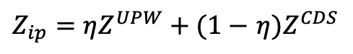
Strategy 1: Blending Upwind and Central
A classic advection stabilization approach is to use a Galerkin (or the central differencing scheme) operator blended with upwind.
Recall, that the Peclet number for an advection/diffusion equation speaks to the ratio of advective transport rate to diffusive transport rate.
In our early stability analysis, recall that monotonicity was only captured when the cell Peclet number was less that 2
We can write the integration point value used as a blended value between the upwind choice and the central operator
The functional form for η varies
In practice, most practical flows drive upwinding
$Z_{ip}=ηZ^{UPW}+(1−$ $η{)Z}^{CDS}$
Hyperbolic tangent with specification of transition and blending

Slide 14
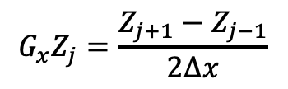
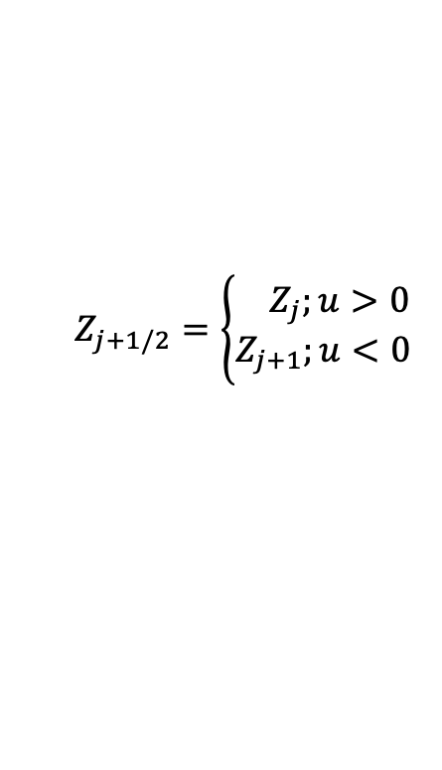
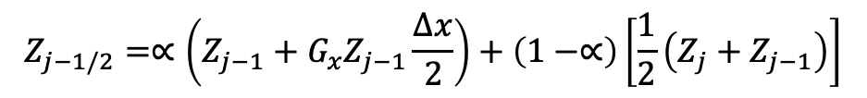
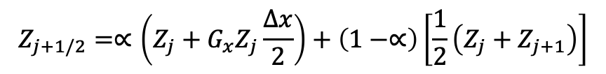
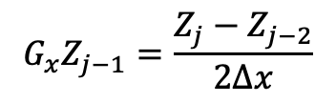
Unwinding to Create Pseudo-higher-order
Upwind advection operators can provide diagonal dominance (at the cost of accuracy)
However, upwind operators, even if higher-order, are numerically diffuse
Higher-order upwind (second-order in space) can be obtained on an unstructured mesh by use of projected nodal gradients and extrapolation:
j-1
Z_{j-1/2}
j
Z_{j+1/2}
j+1
$$Z_{j+1/2}=\left\{\begin{aligned}{ Z}_{j};u>0 \\ Z_{j+1};u<0\end{aligned}\right.$$
“as the wind blows”
$$G_{x}Z_{j}=\frac{Z_{j+1}−Z_{j−1}}{2∆x}$$
$$G_{x}Z_{j−1}=\frac{Z_{j}−Z_{j−2}}{2∆x}$$
$$Z_{j+1/2}=∝\left(Z_{j}+G_{x}Z_{j}\frac{∆x}{2}\right)+\left(1−∝\right)\left[\frac{1}{2}\left(Z_{j}+Z_{j+1}\right)\right]$$
α is a blending
parameter
for u>0
$$Z_{j−1/2}=∝\left(Z_{j−1}+G_{x}Z_{j−1}\frac{∆x}{2}\right)+\left(1−∝\right)\left[\frac{1}{2}\left(Z_{j}+Z_{j−1}\right)\right]$$

Slide 15
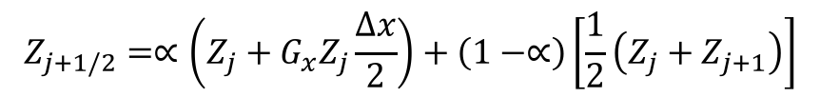
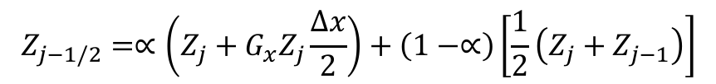
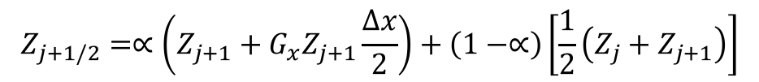
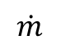
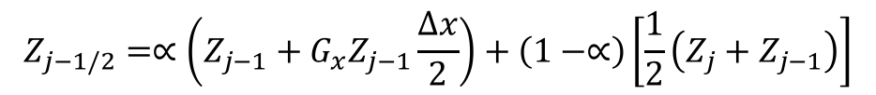
Pseudo Higher-order Upwind
Blending extrapolated upwind with central (Z_{L}+Z_{R})/2 provides:
Slope limiting required when gradients are not smooth (Berger et al, 2005, 43rd AIAA)
$$Z_{j+1/2}=∝\left(Z_{j}+G_{x}Z_{j}\frac{∆x}{2}\right)+\left(1−∝\right)\left[\frac{1}{2}\left(Z_{j}+Z_{j+1}\right)\right]$$
for u>0
$$Z_{j−1/2}=∝\left(Z_{j−1}+G_{x}Z_{j−1}\frac{∆x}{2}\right)+\left(1−∝\right)\left[\frac{1}{2}\left(Z_{j}+Z_{j−1}\right)\right]$$
$$Z_{j+1/2}=∝\left(Z_{j+1}+G_{x}Z_{j+1}\frac{∆x}{2}\right)+\left(1−∝\right)\left[\frac{1}{2}\left(Z_{j}+Z_{j+1}\right)\right]$$
for u<0
$$Z_{j−1/2}=∝\left(Z_{j}+G_{x}Z_{j}\frac{∆x}{2}\right)+\left(1−∝\right)\left[\frac{1}{2}\left(Z_{j}+Z_{j−1}\right)\right]$$
$$\dot{m}$$
j-2 | j-1 | j | j+1 | j+2 | α
1/4 | -5/4 | +3/4 | +1/4 | 0 | 1 | >0
0 | -1/4 | -3/4 | +5/4 | -1/4 | 1 | >0
+1/6 | -6/6 | +3/6 | +2/6 | 0 | 1/2 | <0
0 | -2/6 | -3/6 | +6/6 | -1/6 | 1/2 | <0
Resulting
1-D Stencil

Slide 16
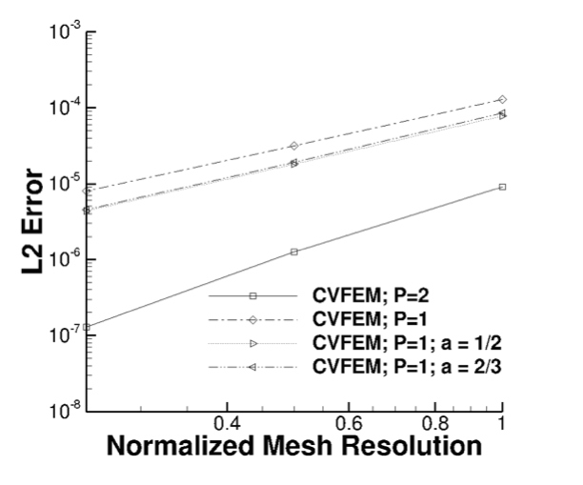
Pseudo Higher-order Upwind
Caveat: In practice, this method provides only a small shift in accuracy
Quadrature error dominated

Slide 17
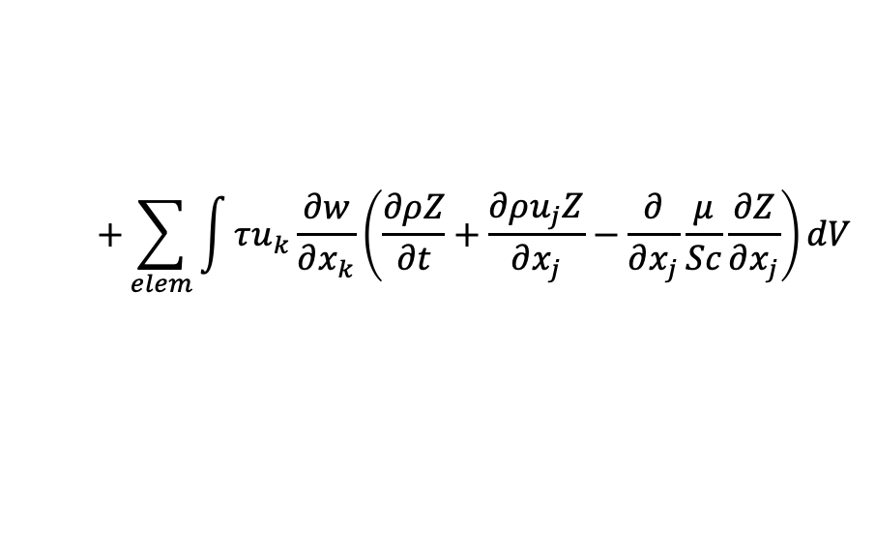


Linear Residual-Based Stabilization: FEM to CVFEM
Is there a better way that either un-stabilized (oscillatory and non-monotonic) and dissipative upwind?
Consider the model advection/diffusion PDE in the context of a FEM
Concept: Add a scaled fine-scale residual for stabilization, Streamwise Upwind Petrov Galerkin (Hughes and Brooks, 1982) – more generalized within the Variational Multiscale Method (VMS, Hughes et. al, 1998)
As noted earlier, CVFEM can be recovered by applying the piecewise-constant test function, w:
Godunuv’s theorem states that a linear stabilization approach is not sufficient to damp out all oscillations
$$\int{w\frac{∂ρZ}{∂t}dV+\int{w\frac{∂ρu_{j}Z}{∂x_{j}}}dV+\int{\frac{∂w}{∂x_{j}}}\frac{μ}{Sc}\frac{∂Z}{∂x_{j}}dV−\int{w}\frac{μ}{Sc}\frac{∂Z}{∂x_{j}}n_{j}dS=0}$$
$$+\sum_{elem}{\int{τu_{k}\frac{∂w}{∂x_{k}}\left(\frac{∂ρZ}{∂t}+\frac{∂ρu_{j}Z}{∂x_{j}}−\frac{∂}{∂x_{j}}\frac{μ}{Sc}\frac{∂Z}{∂x_{j}}\right)}}dV$$
$$−\sum_{elem}{\int{τu_{k}\left(\frac{∂ρZ}{∂t}+\frac{∂ρu_{j}Z}{∂x_{j}}−\frac{∂}{∂x_{j}}\frac{μ}{Sc}\frac{∂Z}{∂x_{j}}\right)n_{k}dS}}$$

Slide 18

Re-visiting Nodal Gradient Operator: An Alternative View
Recall, that the edge- and element-based diffusion operator, and for some choices for the advection operator, and pressure stabilization, a nodal gradient is required
What is a nodal gradient? As formerly described in the Computing Gradients lecture, in a cell-centered context we obtained this via a number of ways, e.g., Green-Gauss, Least Squares, etc.
Let’s take another view…
First, the gradient of a function for ordinary finite element basis functions are discontinuous, i.e., the value at a shared element face depends on which element is used to compute the gradient
Therefore, we can view the nodal gradient a continuous at the nodes and discontinuous within the elements
Let’s minimize this difference:
by solving:
Lumped-mass

Slide 19

Re-visiting Nodal Gradient Operator: Convergence
On a Quadratic Unstructured Quad element, we see that second-order convergence of the projected nodal gradient is only noted when a consistent mass matrix is used (requires a matrix inversion, or an outer iteration for an explicit scheme)
Lack of design-order projected nodal gradients affect the design-order expectation for the DOFs velocity and pressure! No real extension of reconstruction schemes to higher-order

Slide 20







Linear Residual-Based Stabilization: CVFEM closer look
For now, let’s remove time, diffusion and source – and assume density and velocity are constant
Recall central and upwind stencils for our standard 1D configuration (flow left to right)
General interpretation: looks like diffusion with coefficient, $τuρu$, where $τ$ is a flow-aligned time scale (s)
If we allow Let $τ=\frac{Δx}{2\left|u\right|}$, then we recover upwind!
$$\int{ρu_{j}Z}n_{j}dS−\sum_{elem}{\int{τu_{k}\left(\frac{∂ρu_{j}Z}{∂x_{j}}\right)n_{k}dS=0}}$$
$$\sum_{ip}{\dot{m}Z_{ip}−τu_{k}A_{k}ρu_{j}\sum_{ip}{\frac{∂Z}{∂x_{j}}}}$$
$$\dot{m}\left(Z_{j+1}−Z_{j−1}\right)=0$$
$$\dot{m}\left(Z_{j}−Z_{j−1}\right)=0$$
j-1
Z_{j-1/2}
j
Z_{j+1/2}
j+1
_{A}
$$u$$
$$\dot{m}\left(Z_{j+1}−Z_{j−1}\right) −τuρu\frac{\left(Z_{j+1}−{2Z}_{j}+Z_{j−1}\right) }{Δx}A$$

Slide 21




Linear Residual-Based Stabilization: Consistency?
The residual-based stabilization is given by,
with the fine-scale residual defined as,
Comments:
If the fine-scale residual is consistently evaluated, then as the mesh is refined the residual-based stabilization is removed
Recall that this is a linear stabilization scheme and may still admit oscillations
In the pure Finite Element Method description, this form of stabilization is a Petrov-Galerkin approach
with
$$\int{\frac{∂ρZ}{∂t}dV+\int{\left(ρu_{j}Z−\frac{μ}{Sc}\frac{∂Z}{∂x_{j}}\right)}n_{j}dS−\sum_{elem}{\int{τu_{k}n_{k}R^{h}(Z) dS}}}$$
$$R^{h} \left(Z\right)=\frac{∂ρZ}{∂t}+\frac{∂ρu_{j}Z}{∂x_{j}}−\frac{∂}{∂x_{j}}\frac{μ}{Sc}\frac{∂Z}{∂x_{j}}$$
$$\sum_{elem}{\int{\tilde{w}\left(\frac{∂ρZ}{∂t}+\frac{∂ρu_{j}Z}{∂x_{j}}−\frac{∂}{∂x_{j}}\frac{μ}{Sc}\frac{∂Z}{∂x_{j}}\right)}}dV=\sum_{elem}{\int{\tilde{w}R^{h}\left(Z\right) }}$$
$$\tilde{w}=w+τu_{k}\frac{∂w}{∂x_{k}}$$

Slide 22




SUPG in Practice (CVFEM and FEM)
SUPG and analog in CVFEM, Streamwise Upwind Control Volume (SUCV) are effective for low-moderate cell-Peclet numbers
Un-stabilized and SUPG
Convecting TV
SUPG/SUCV back step velocity prediction

Slide 23
What above Variational Multiscale Methods?
See:
https://nalu.readthedocs.io/en/latest/source/theory/rteStabilization.html

Slide 24
Nonlinear Stabilization Approach
Consider a general transport equation for φ
An artificial viscosity approach is provided with coefficient again related to a fine-scale residual:
Piecewise-constant test function for CVFEM (with fourth order-form)
Similar concept to Guermond’s “Entropy-viscosity” approach, 2013
Can also form an interesting LES model when the viscosity is a function of the k.e. fine scale residual (Guermond and Larios, 2015) – see Nalu theory for more information…
,
,
FEM-based DCO (Shakib, 91)
Co-variant and contra-variant metric tensors
or min…..
Coefficient based on local residual
Limit the coefficient based on an upwind analogy

Slide 25
Now, Direct Comparisons…
Transient scalar advection/diffusion transport (Re 2000); Mojtabi and Deville, Comput. Fluids, 2015

Slide 26
Now, Direct Comparisons, Order of Accuracy
Convecting Taylor/Vortex simulation at high crossflow velocity
Results demonstrate the ability to deploy this stabilization approach to high-order

Slide 27
Advection Operators: Conclusion
Without diagonal dominance, lack of monotonicity is noted
Upwind approaches can help, however, comes at the price of numerical accuracy
Residual-based approaches, which stem from the FEM literature, are useful candidates for CVFEM

